Slide 1

Approaches to text analysis
in the Humanities
Sarah McEleney, The University of Virginia

Slide 2
Today’s Outline
1) Discussion of historical approaches to reading texts and review of technologies. Discussion of text analysis with DH. Ways to read a text, voyant, Google n-grams, online tools with no programming needed.
2)Basic python and text analysis tutorial — Follow along with handouts, discussion of python and text analysis
3) Mini-project — your own pythonic literary analysis of a work of English literature. Answer 3-4 of the given questions of your choice, and make a python script to answer them. (Use “cookbook” worksheet)
4) Share mini-projects in groups
5) A look at further resources

Slide 3
Concepts: Ways to Read A Text
Close reading - general literary theory, before digital approaches
Bag of Words, vocabulary statistical method
Topic Modeling
Sentiment Analysis

Slide 4
Close Reading vs. Distant reading
Close reading
Every detail matters
Every detail matters whether the author intended them or not
In most cases, assumes that meaning is hidden
You have to uncover meaning by connecting small details
Context matters
Distant reading
Franco Moretti

Slide 5
Natural Language Processing and Text Analysis
Applications in humanities research
Matthew Jockers’ “The Bestseller Code”
show a few neat example projects

Slide 6
Word Frequency / Bag of Words
Sentence A:
"Barbara is doing fine, thank you."
Sentence B:
"Thank you, Dave. I am doing fine.”
Sentence C:
“I am Dave.”
Counts for Sentences
A: [1, 1, 1, 1, 1, 1, 0, 0, 0]
B: [0, 0, 1, 1, 1, 1, 1, 1, 1]
C: [0, 0, 0, 0, 0, 0, 1, 1, 1]
Words in Corpus
[
"Barbara",
"is",
"doing",
"fine",
"thank",
"you",
"Dave,
"I",
"am"
]

Slide 7
Word Frequency/ Bag of Words
Sentence A:
"Barbara is doing fine, thank you."
Sentence B:
"Thank you, Dave. I am doing fine.”
Sentence C:
“I am Dave.”
Counts for Sentences
A: [1, 1, 1, 1, 1, 1, 0, 0, 0]
B: [0, 0, 1, 1, 1, 1, 1, 1, 1]
C: [0, 0, 0, 0, 0, 0, 1, 1, 1]

Slide 8
Word Frequency / Bag Of Words
A: [1, 1, 1, 1, 1, 1, 0, 0, 0]
B: [0, 0, 1, 1, 1, 1, 1, 1, 1]
C: [0, 0, 0, 0, 0, 0, 1, 1, 1]
A and C are inverses – share nothing.
B shares 4 terms with A
C shares 5 terms with A
Sentences Graphed by Similarity
A------------------B----------C

Slide 9
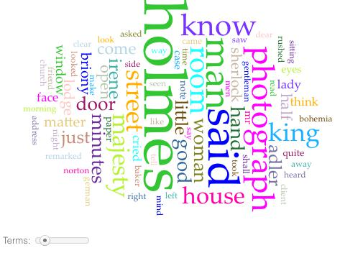
Bag of Words in Voyant
voyant-tools.org

Slide 10
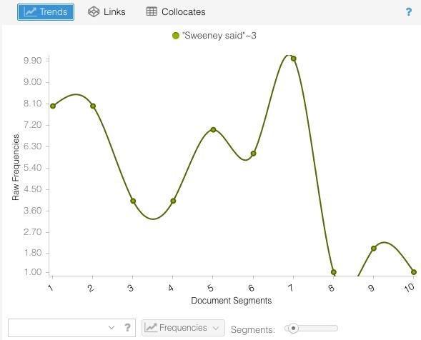
Voyant

Slide 11


Using Voyant:
Go to voyant.com and type in
a url from wikipedia in the
prompt, such as
https://en.wikipedia.org/wiki/Digital_humanities

Slide 12
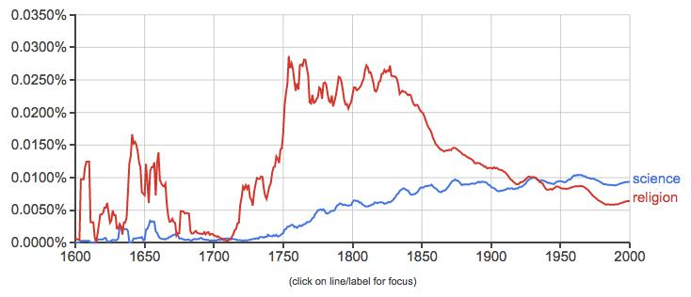
Google N-Grams
https://books.google.com/ngrams

Slide 13
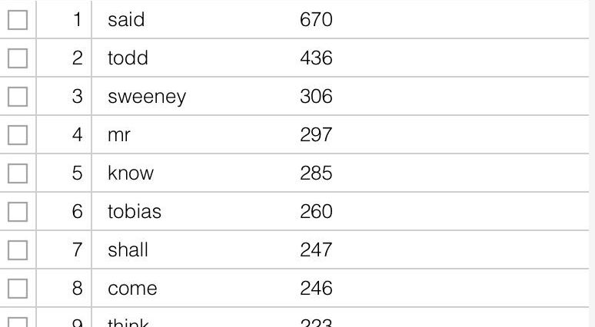
Concordance with Stopwords

Slide 14
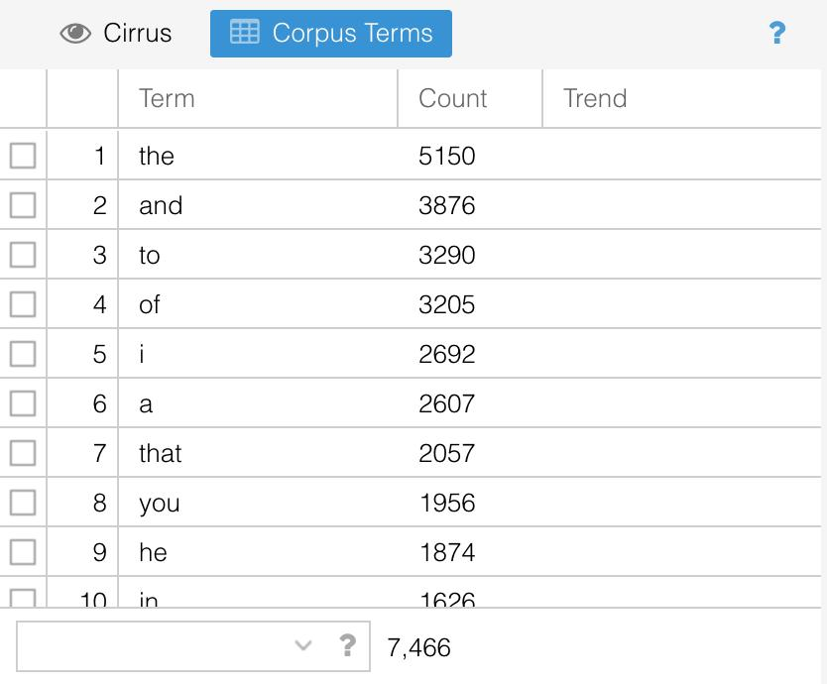
Concordance Without Stopwords

Slide 15
Further Applications with text analysis

Slide 16
Topic Modeling
Variation of Bags of Words
Texts are about something – themes/topics
Vocabulary lets us know this.
So if we know the words, we can infer the topics.
But, more specifically, we want to look at clusters of words.

Slide 17
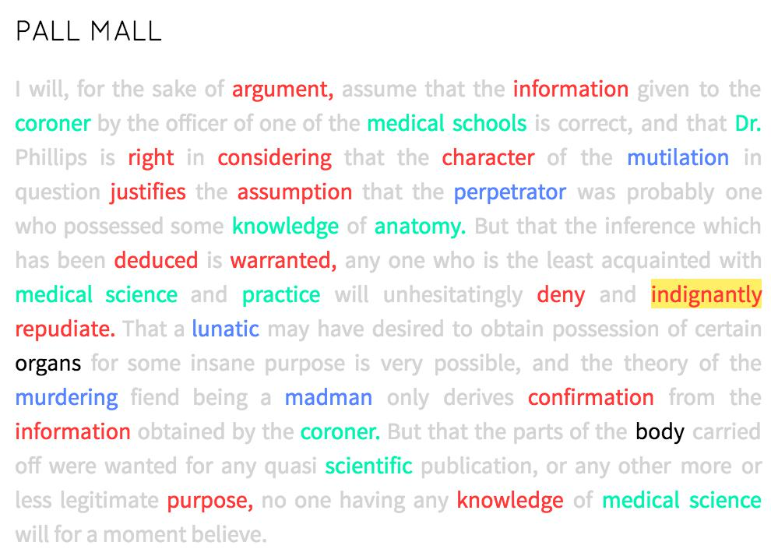
Topic Modeling
red: evidence
green: medicine
blue: murder

Slide 18
Topic Modeling
Runs over a corpus
Pulls out statistically significant clusters of words in each document
More sophisticated than simple word counts
Gets at underlying themes/topics in docs

Slide 19
Sentiment Analysis
"It
was
the
best happy!/positive/1
of
times,
it
was
the
worst sad!/negative/0
of
times…"

Slide 20
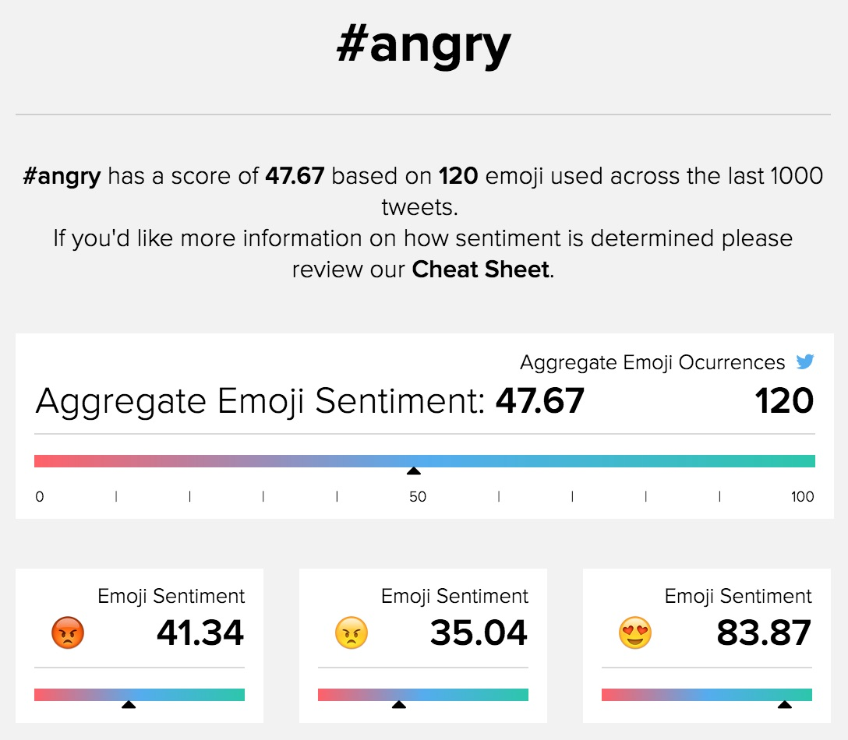
Sentiment Analysis
emojisentiment.com

Slide 21
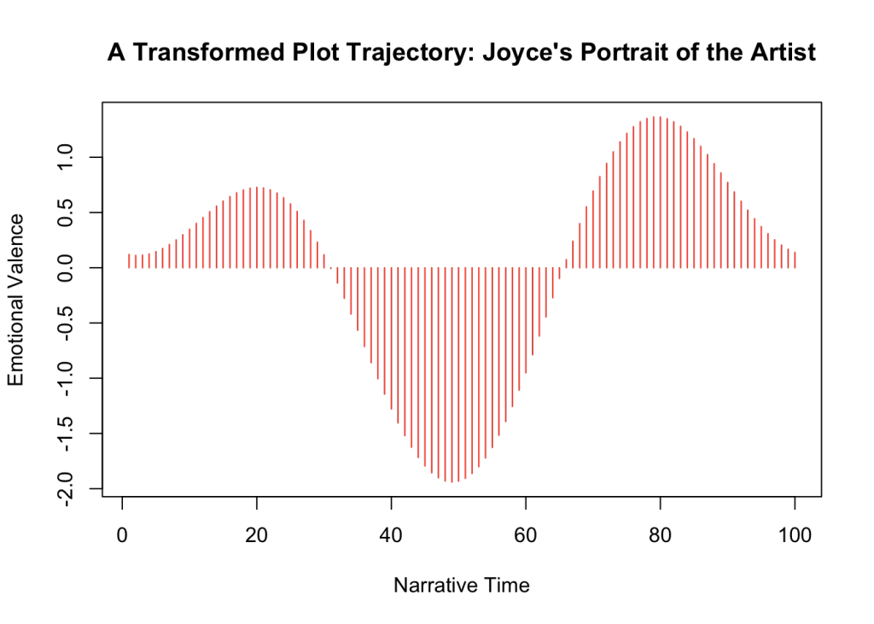
SenTiment Analysis
http://www.matthewjockers.net/2015/02/02/syuzhet/

Slide 22
Recap of Online Resources to Explore
As we’ve seen, you can do some interesting things with quantitative text analysis without ever programming at all! You may want to explore the following online resources further:
voyant
google n-grams
emojisentiment.com

Slide 23
Recap of Applications for Text Analysis
Two applications we discussed for text analysis from a conceptual point of view were:
Topic modeling
Sentiment analysis

Slide 24
Group Mini-Project
Distant reading a short story
Read this as a class, using pre-written python scripts, opportunity to talk about programming

Slide 25
Preliminaries: Text analysis with python tutorial
Python prefers .txt files
.txt and .csv are known as “flat” files, and are much easier for python to parse than documents that take up more memory like Word and Excel files
.pdf files need to be converted into .txt files for text analysis. For example, the Ring Turn Phi Archive in your course homework needs to undergo OCR (optical character recognition) before it will be usable for digital text analysis.

Slide 26
Preliminaries: Text analysis with python tutorial
Text needs to be “cleaned” for best results
You will learn more about this later in your course

Slide 27
Tutorial Script #1
We are going to read in a short story as a flat .txt. file.
Open your tutorial script in IDLE or another text editor
Look at the following line:
This declare a variable called ‘story’ and places the entire text into it
story = open( 'story.txt', mode='r', encoding='utf8').read()

Slide 28
Lists in Python
A list is a variable that is collection of numerous different elements.
An individual element of a list can be called by referencing its index.
anexamplelist = [‘computer’,’tree’,17, 2.5]
print (anexamplelist[1])
## ‘tree’

Slide 29
For Loops
A control flow statement that allows a process to be iterated (repeated)
catbreeds = ["persian", "tabby", "sphinx", "domestic shorthair"]
for breed in catbreeds:
print (breed)

Slide 30
Defining Functions
We saw some in-built python functions. Let’s write our own now. Functions are declared with the def keyword in python.
def multiplysomething(thethingtobemultiplied):
product = thethingtobemultiplied * 2
return product
result = multiplysomething(5)
print (result)

Slide 31
If Statements
vegetables = [“peas”,”celery”,”broccoli”,”cauliflower”,
”carrots”,”parsnips”, “tomato”]
for vegetable in vegetables:
if len(vegetable) < 5:
print ("short word")
elif len(vegetable == 5:
print (“medium word”)
else:
print (“long word”

Slide 32
Tutorial Script #2 — Using Common Python Packages
In our last “package-free” python script, we created tokens using the split() function on string to create a list.
However, there are some downsides to this, an nltk makes this easier.
Let’s take a loop at tutorial script #2 to see some different things that can be done with the nltk package, as well as the matplotlib package.

Slide 33
Individual Mini-Project
1) Go to Project Gutenberg (projectgutenberg.com) and choose any work of English literature. Download it as a .txt file.
With your worksheet, choose 4 questions that you want to answer about your text. (15 approaches available — 5 for advanced students, with nltk)
Using your “cook book”, try to write the code necessary to help answer your questions.

Slide 34

What next?Further Resources For Text Analysis with Python

